Slide 1

Heuristic Search 2
Non-Greedy Optimisation Methods
Week 9

Slide 2
Contents
Hill Climbing
  Random Restart Hill Climbing (RRHC)
  An Example of RRHC Implementation
  Stochastic Hill Climbing (SHC)
  Examples - experiments
Tabu Search

Slide 3
Random Restart Hill Climbing (RRHC)
A very effective version of the Hill Climbing algorithm is the Random Restart (RRHC) version
Here we run the normal RMHC algorithm a number of times and record the best
  I.e. we start off in different sections of the search space
  For example, we might run it 10 times for 100 iterations rather than once for 1,000 iterations

Slide 4
Hill Climbing – RRHC
RRHC iterations = RMHC Iterations/Restarts
There are 10 restarts (of hill climbing).
If Random Mutation needs to run 10000
iterations to search the solution for the
problem, however, RRHC will need to have
1000 iterations for each restart.
Hill Climbing initial point
Search Space

Slide 5
Hill Climbing - RRHC
The RRHC algorithm is as follows:
Algorithm 1. RRHC
Input: ITER- the number of iterations to run for RMHC
Restart – the number of restarts
1) For i = 1 to Restart
2) Run Algorithm 2 (RMHC) with ITER = ITER/Restarts
3) Save the solution from RMHC
4) End For
Output: S- a list of solutions from restarts

Slide 6
Hill Climbing - RMHC
The Random Mutation Hill Climbing algorithm is as follows:
Algorithm 2. RMHC
Input: ITER- the number of iterations to run for
1) Let S be a random point in the search space,
let F be its fitness(S)
2) For i = 1 to ITER
3) Let S’ be a random point close to S (small change)
4) Let F’ be its fitness (S’)
5) If F’ is better than F Then
6) Let S = S’ and Let F = F’
7) End If
6) End For
Output: S- a solution

Slide 7

Hill Climbing Implementation
The Scales Problem
  Find the solution for arranging 10 weights on the scale.
The Scales class
  A solution
  A fitness
  All other methods
The Hill Climbing class
  The parent class to the Scales class
  Takes a dataset for the problem
  All other methods

Slide 8
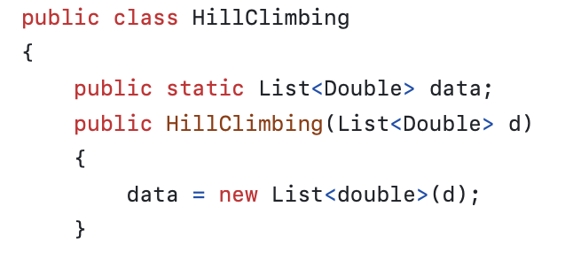
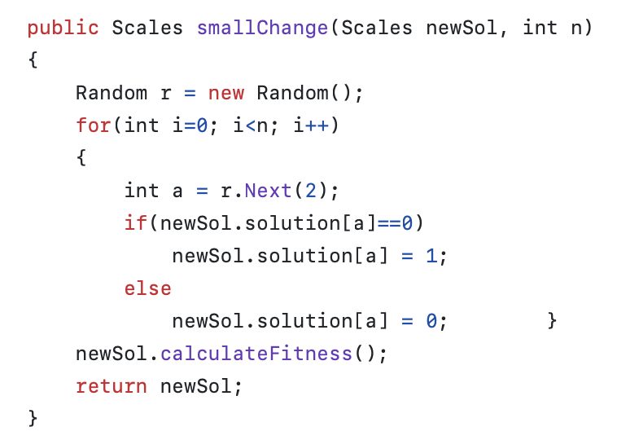
Hill Climbing Implementation – Hill Climbing Class
And other methods such as smallChange and runHC,

Slide 9
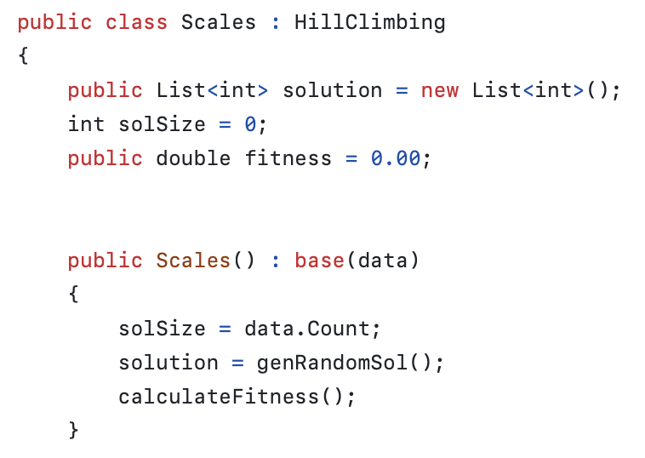
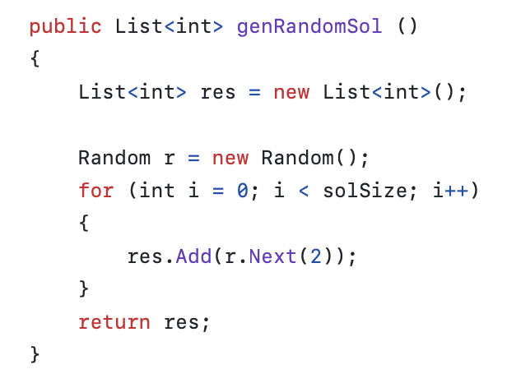
Hill Climbing Implementation – The Scales Class
And other methods such as calculateFitness, copySolution etc…

Slide 10

Let’s see a demonstration on Hill Climbing for Scales Problem

Slide 11

Break 5 minutes!

Slide 12
Stochastic Hill Climbing
We need to improve RMHC to escape local optima
We can do this by letting the algorithm accept worse fitness function values during its search
This is the basis of the Stochastic Hill Climbing (SHC) algorithm
  The chance of accepting is a function of how bad the change is
  A very bad change will have a small chance of being accepted
  A slightly bad change will be accepted more often
  There are many ways of doing this, the example decision function in the next slide is just one of these ways…

Slide 13
Stochastic Hill Climbing
We accept (line 5 in the RMHC algorithm) a new solution according to the following equation:
Here:
  f′ is the new fitness (line 3 in the RMHC algorithm)
  f is the old fitness
  T is a parameter (set to 25 for the 1,000 primes scales problem)
The correct choice of T can be very difficult...

Slide 14
Stochastic Hill Climbing
The Stochastic Hill Climbing algorithm is as follows:
Stochastic Hill Climbing Algorithm
Input: ITER- the number of iterations to run for
t – threshold of acceptance, t∈ℝ, such that 0<t<1
1) Let S be a random point in the search space,
let F be its fitness(S)
2) For i = 1 to ITER
3) Let S’ be a random point close to S (small change)
4) Let F’ be its fitness (S’), Pr = Equation1
5) If Pr >= t
6) Let S = S’ and Let F = F’
7) End If
6) End For
Output: S- a solution
Equation1
Pr = 1/1+(e^{(f’-f)/T})

Slide 15
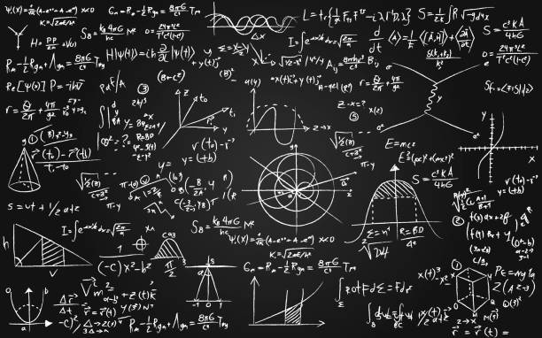
Let’s see how the Pr equation works!

Slide 16

Let’s see some examples for SHC experiments

Slide 17
Tabu (Taboo) Search
Tabu search tries to model human memory processes
  Key idea: Use aspects of search history (memory) to escape from local minima
A tabu-list is maintained throughout the search
  Associate tabu attributes with candidate solutions or solution components
  Moves according to the items on the list are forbidden

Slide 18
Flow Chart of a Standard Tabu Search Algorithm
START
Initialise solution
Create a candidate
list of solutions
Evaluate solutions
Stopping conditions
satisfied?
Update Tabu &
Aspiration
Conditions
No
Choose the best
admissible solution
Yes
END
Final solution

Slide 19
Tabu Search – Key Concepts
A search (similar to Hill Climbing) that remembers sets of points in the search space
  These are called the Tabu list and are to be avoided
The idea is that this helps in avoiding local optima
However, if a point is evaluated to be better than any points discovered so far, then the Tabu list may be updated
  Aspiration Criteria

Slide 20
Tabu Search Stopping Conditions
Some immediate stopping conditions:
  No feasible solution in the neighborhood of solution
  The maximum amount of iterations or CPU time has been exceeded
  The number of iterations since the last improvement is larger than a specified number
  Evidence can be given than an optimum solution has been obtained

Slide 21
Parameters of Tabu Search
Local search procedure
Neighborhood structure
Tabu attributes
Aspiration conditions
Form of tabu moves
Maximum size of tabu list
Stopping rule

Slide 22
Pros and Cons for Tabu Search
Pros:
  The use of a Tabu list
  Can be applied to both discrete and continuous solution spaces
  A meta-heuristic that guides a local search procedure to explore the solution space beyond local optimality
  For larger and more difficult problems (scheduling, quadratic assignment and vehicle routing), tabu search obtains solutions that rival and often surpass the best solutions previously found by other approaches
Cons:
  Too many parameters to be determined
  Number of iterations could be very large
  Global optimum may not be found, depends on parameter settings
  Tabu list can grow out of control

